Slide 1
Kentucky All Schedule
Prescription Electronic Reporting
Quarterly Trend Report
2nd Quarter 2024 Cabinet for Health and Family Services
Office of Inspector General
275 E. Main Street
Frankfort, KY 40621

Slide 2
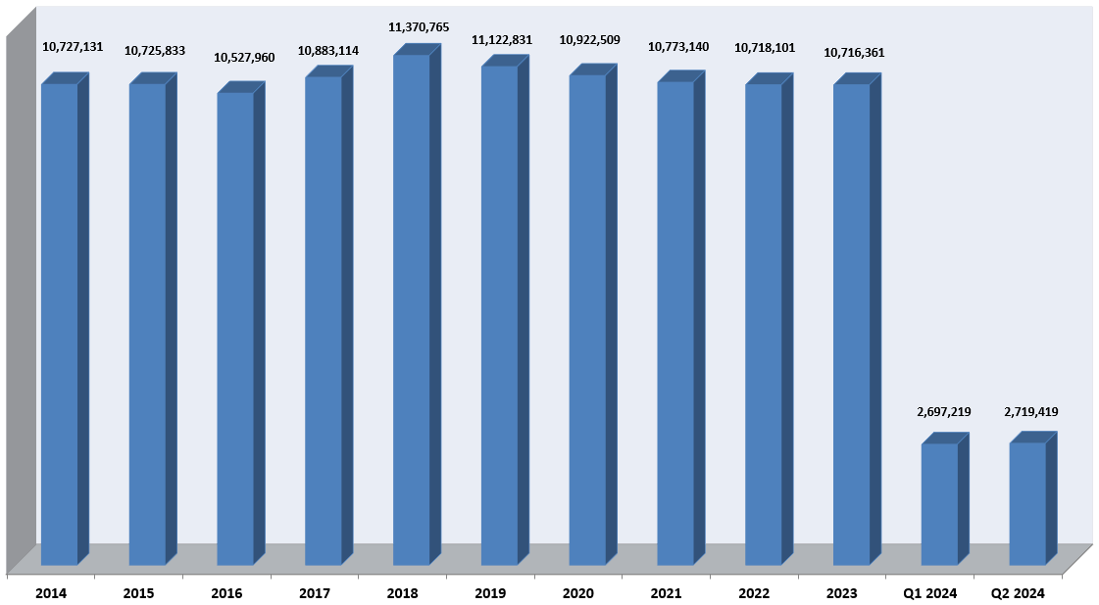
KASPER Records Added 2014 – Q2 2024

Slide 3
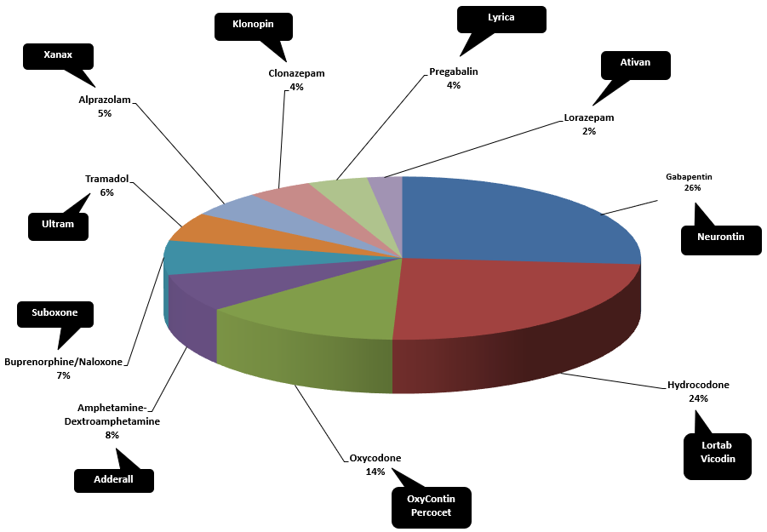
Top Prescribed Controlled Substances by Therapeutic Category by Doses – Q2 2024

Slide 4
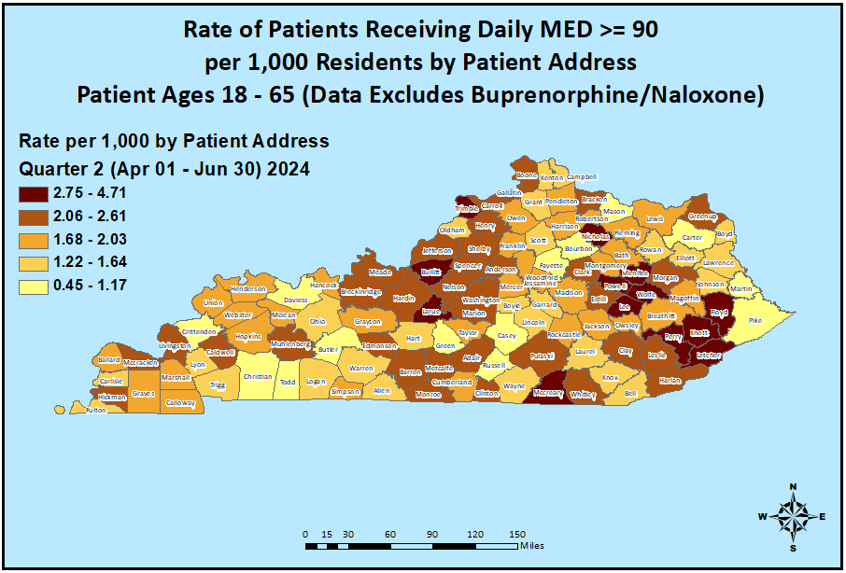
Opioid Morphine Equivalent Dose (MED) Data Q2 2024

Slide 5
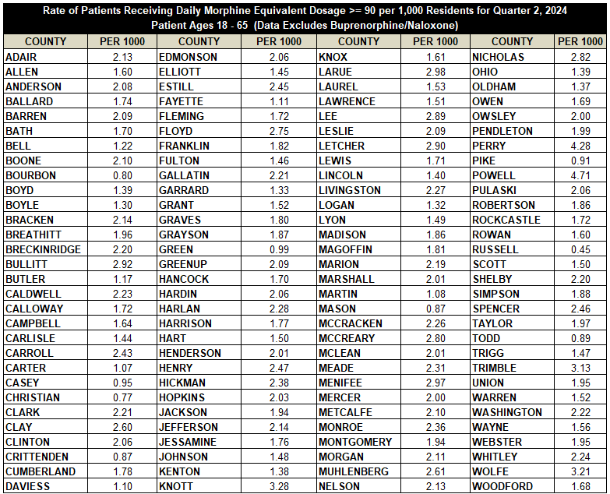
Opioid Morphine Equivalent Dose (MED) Data Q2 2024

Slide 6
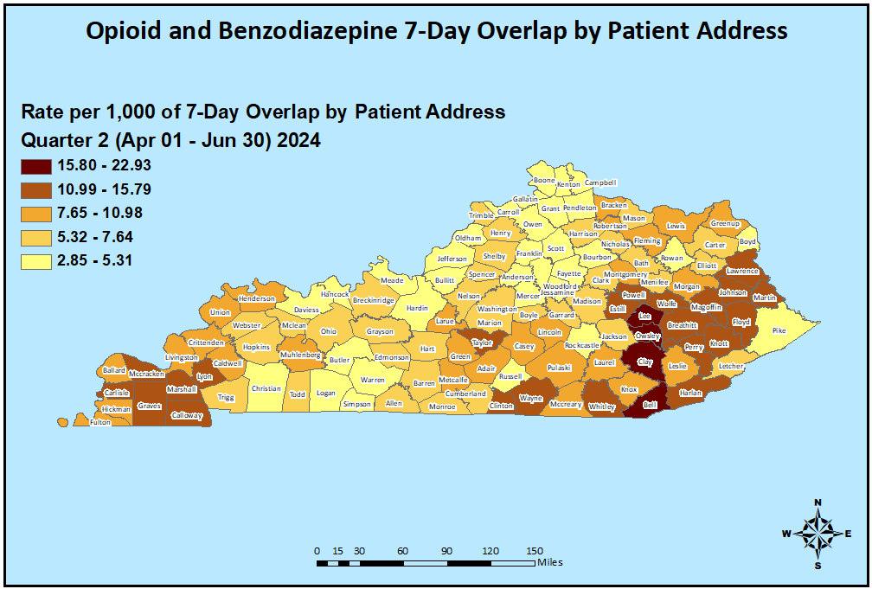
Patients with Seven or More Days of Overlapping Opioid
and Benzodiazepine Prescriptions Q2 2024

Slide 7
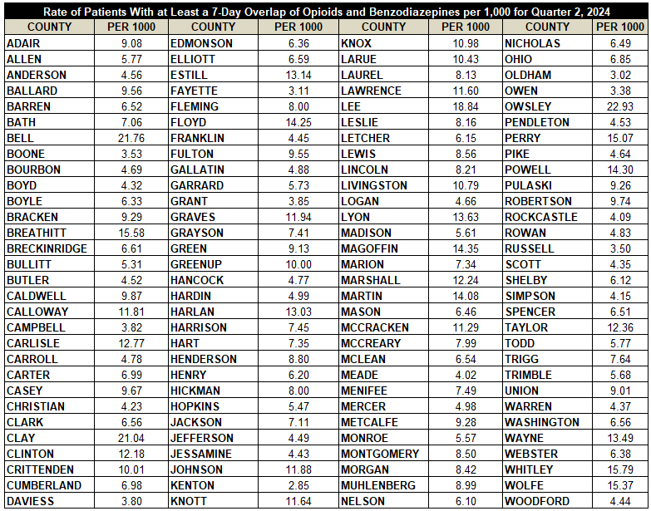
Patients with Seven or More Days of Overlapping Opioid
and Benzodiazepine Prescriptions Q2 2024

Slide 8
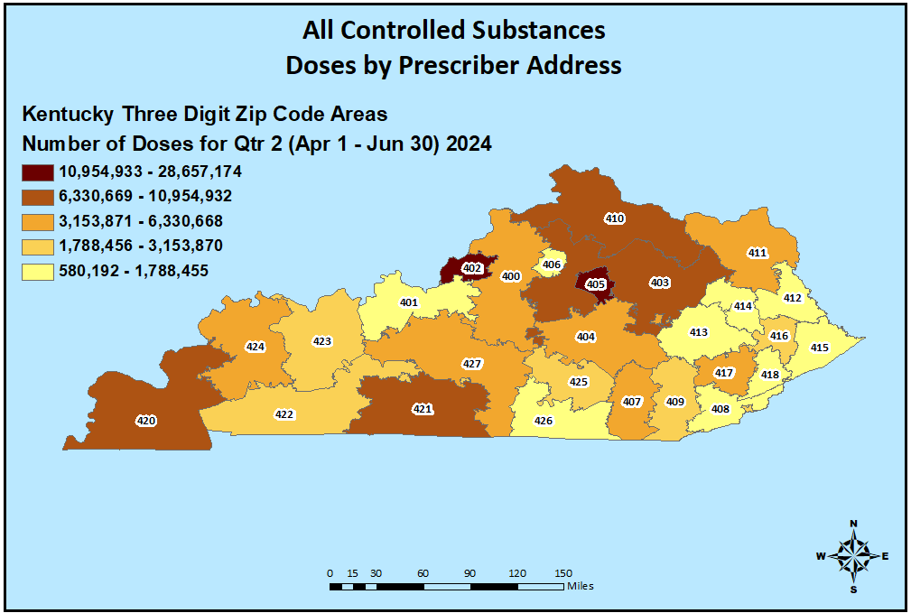
Controlled Substance Prescribing Q2 2024

Slide 9
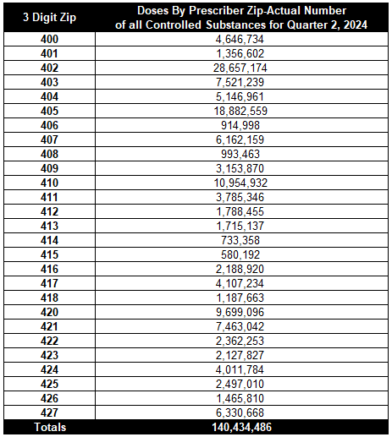
Controlled Substance Prescribing Q2 2024

Slide 10
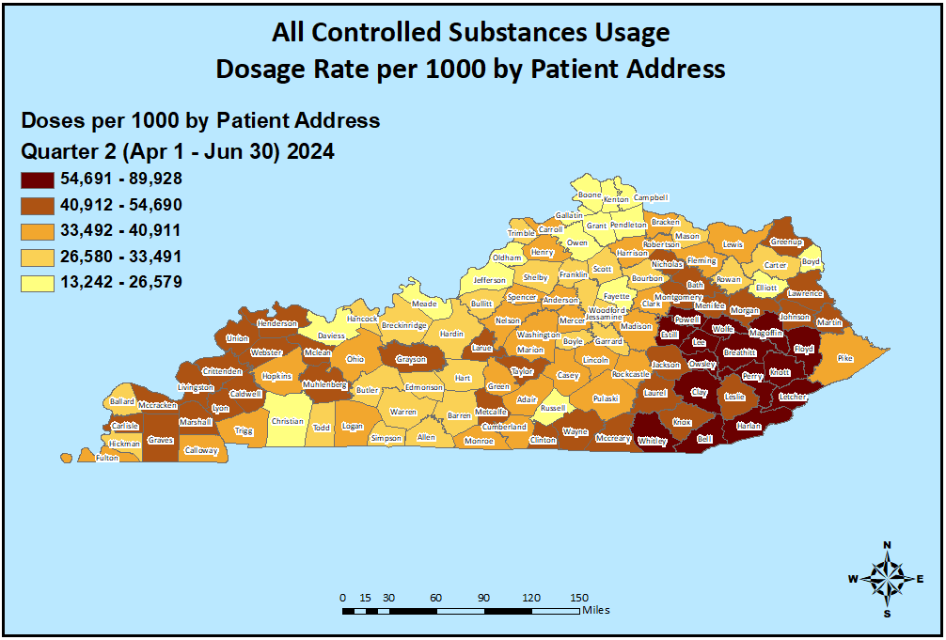
Controlled Substance Usage Q2 2024

Slide 11
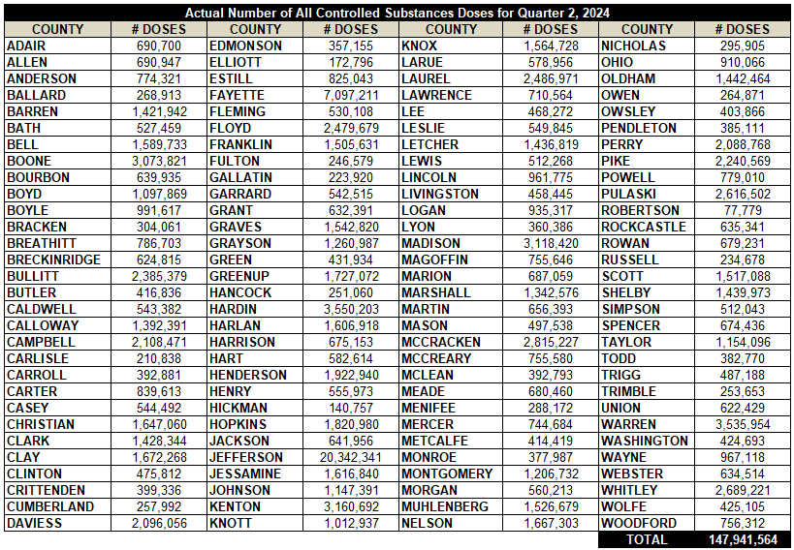
Controlled Substance Usage Q2 2024

Slide 12
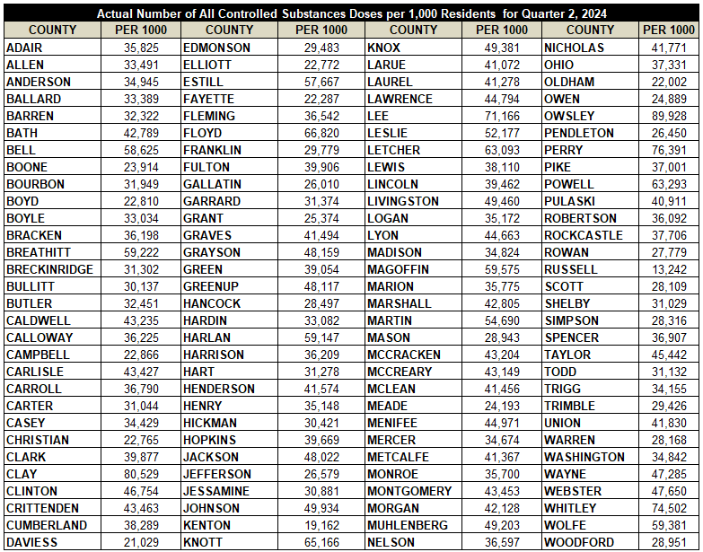
Per 1000 Controlled Substance Usage Q2 2024

Slide 13
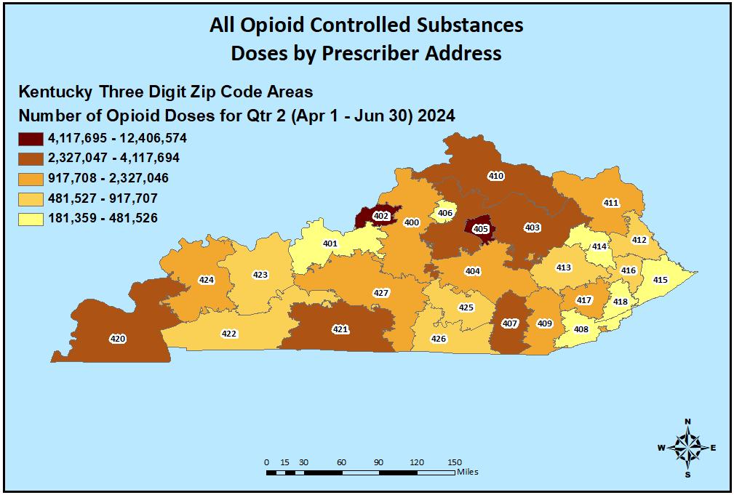
Opioid Prescribing Q2 2024

Slide 14
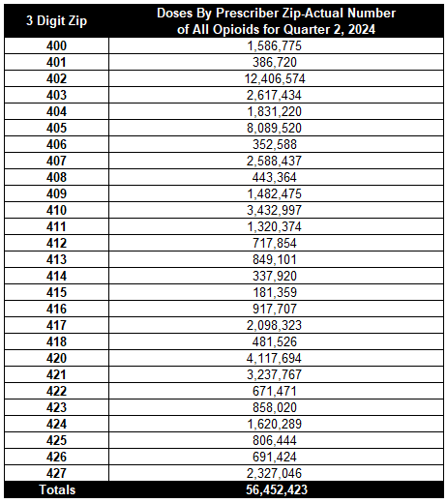
Opioid Prescribing Q2 2024

Slide 15
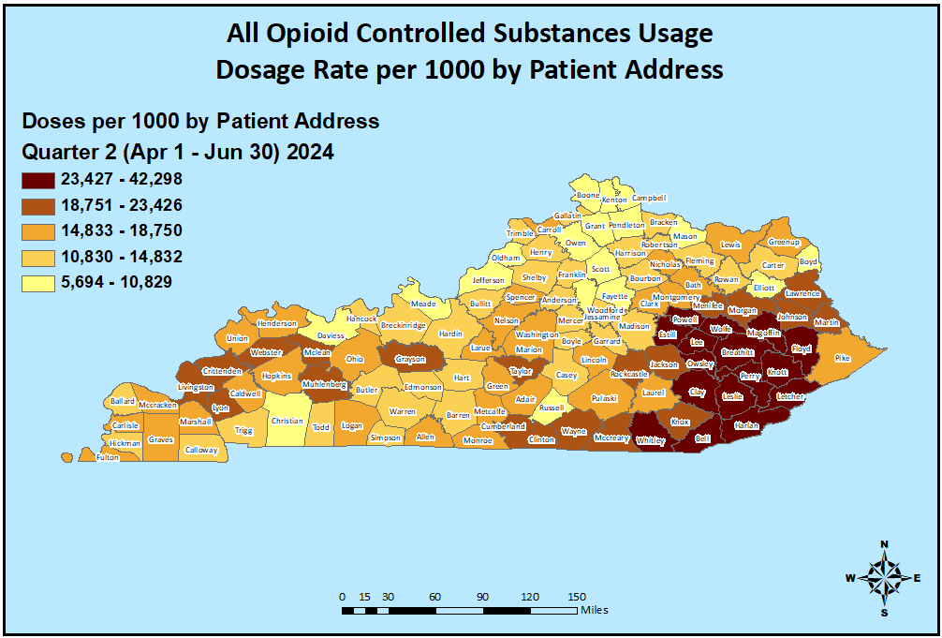
Opioid Usage Q2 2024

Slide 16
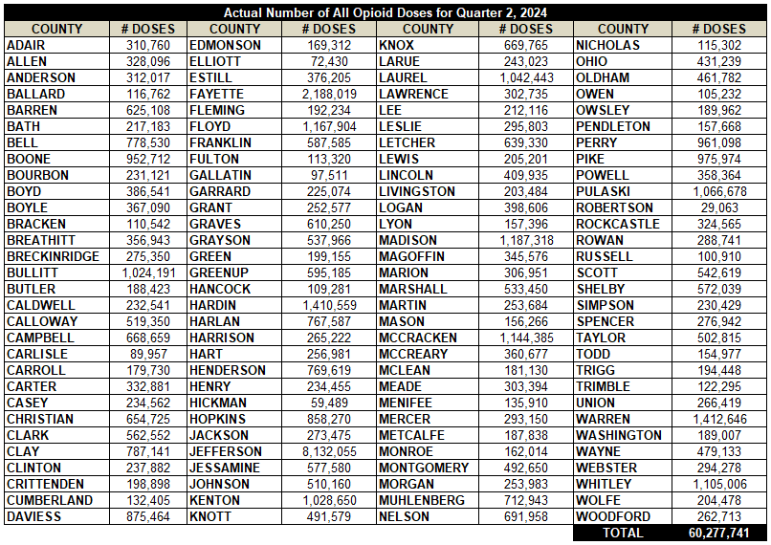
Opioid Usage Q2 2024

Slide 17
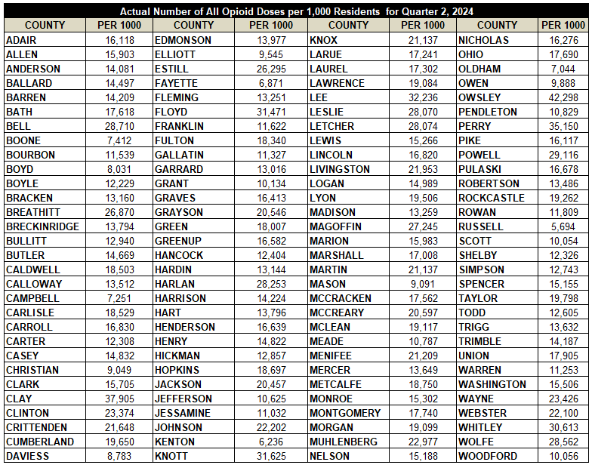
Per 1000 Opioid Usage Q2 2024

Slide 18
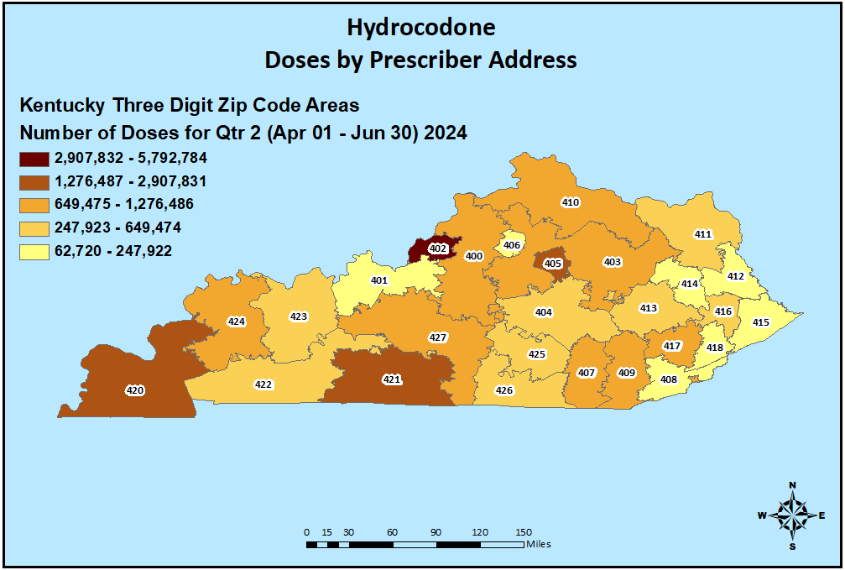
Hydrocodone Prescribing Q2 2024

Slide 19
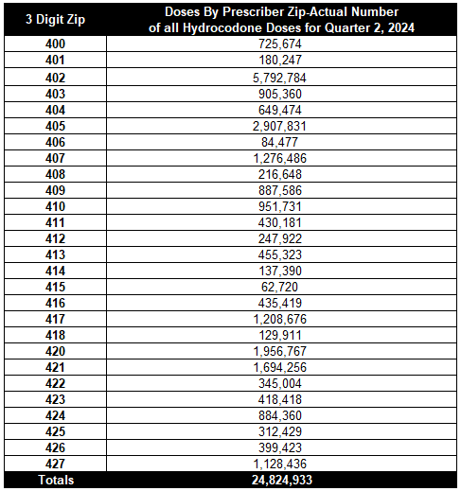
Hydrocodone Prescribing Q2 2024

Slide 20
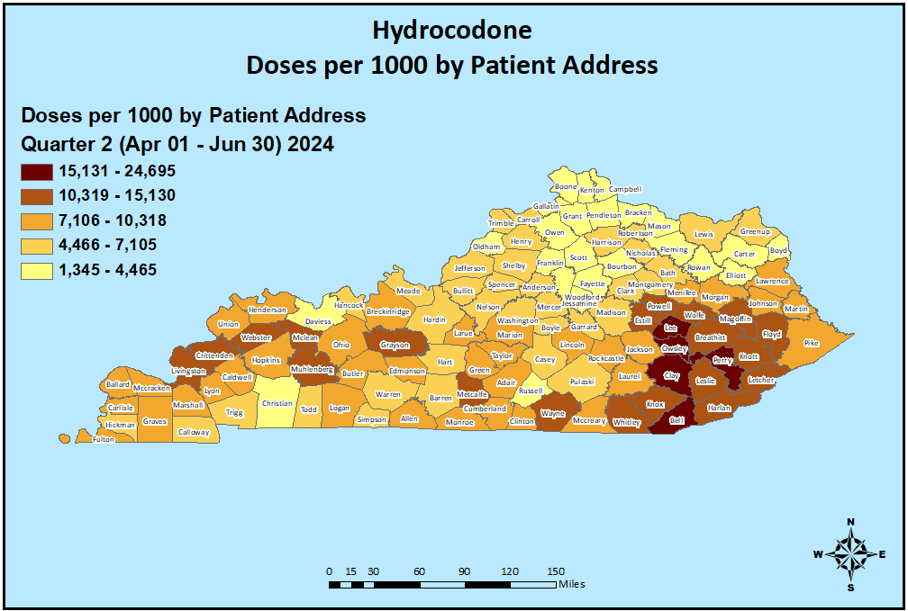
Hydrocodone Usage Q2 2024

Slide 21
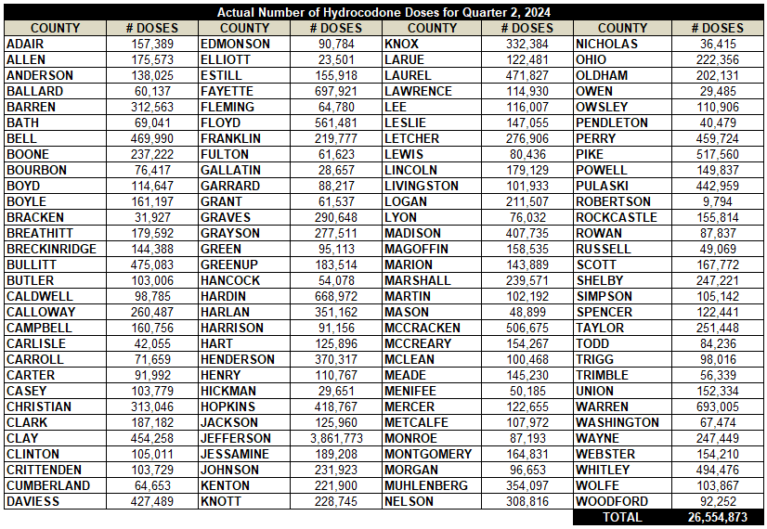
Hydrocodone Usage Q2 2024

Slide 22
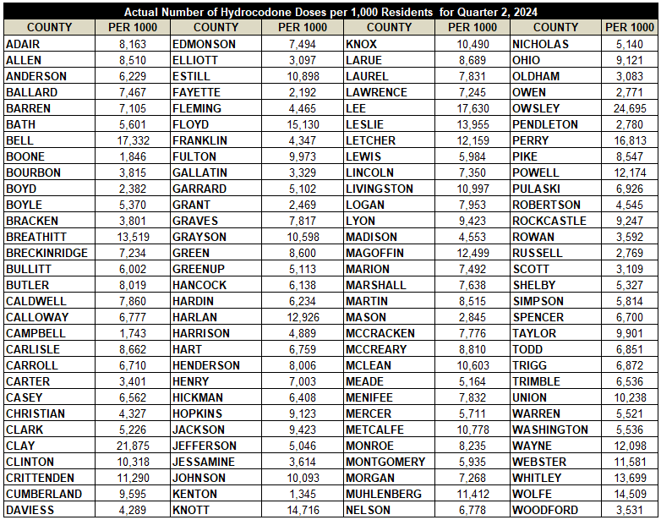
Per 1000 Hydrocodone Usage Q2 2024

Slide 23
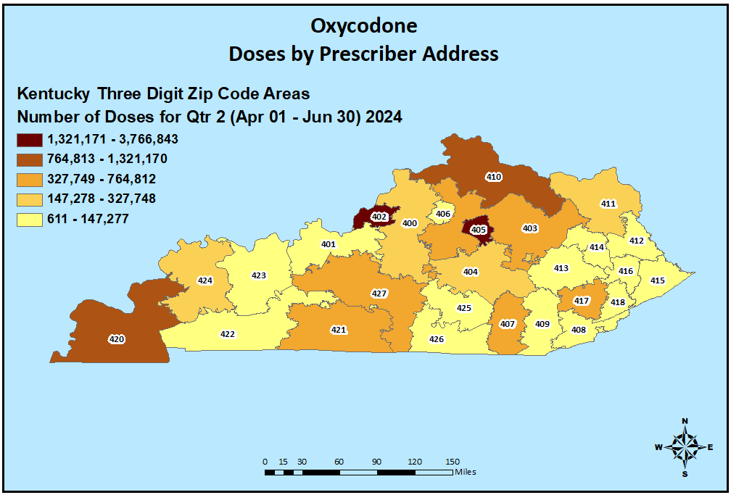
Oxycodone Prescribing Q2 2024

Slide 24
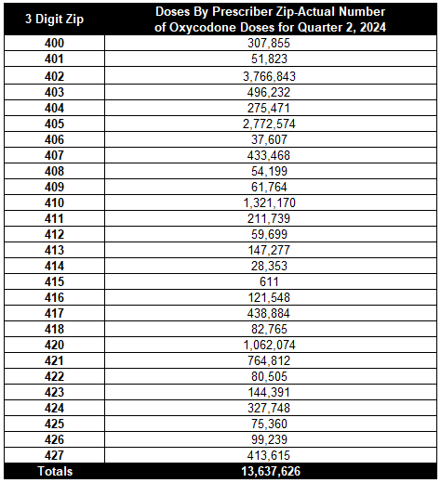
Oxycodone Prescribing Q2 2024

Slide 25
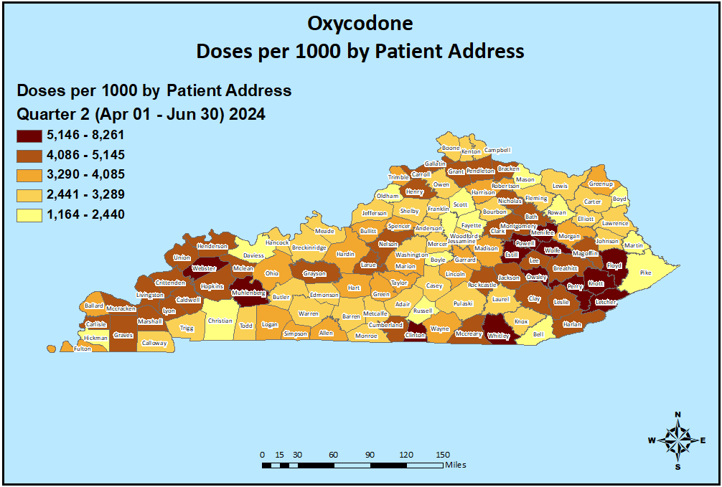
Oxycodone Usage Q2 2024

Slide 26
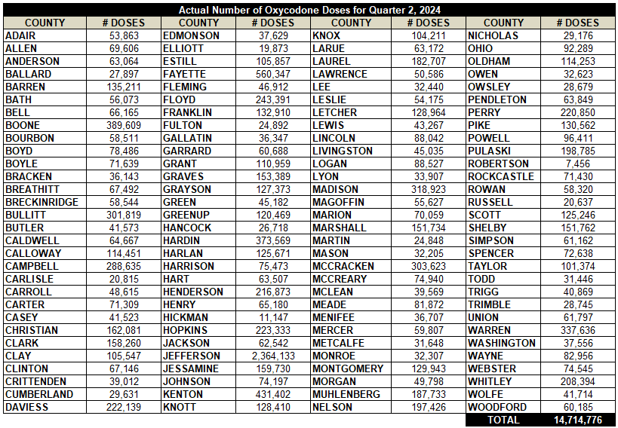
Oxycodone Usage Q2 2024

Slide 27
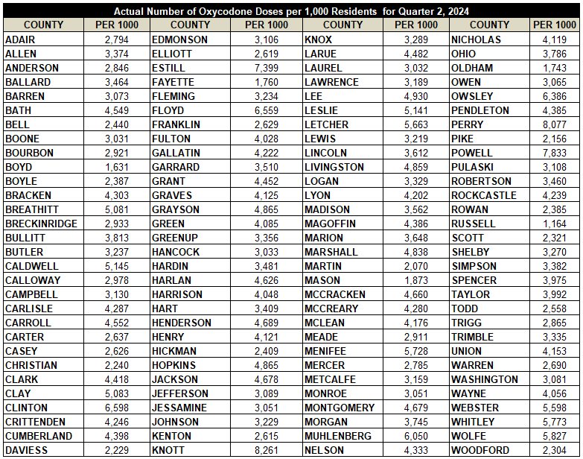
Per 1000 Oxycodone Usage Q2 2024

Slide 28
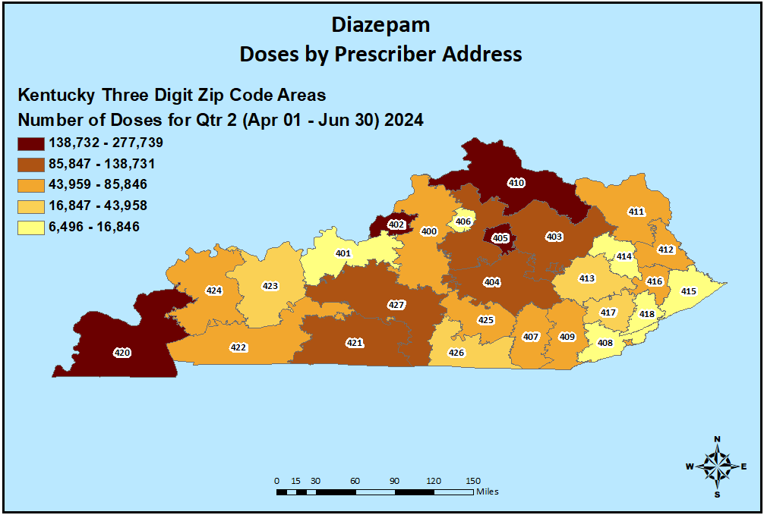
Diazepam Prescribing Q2 2024

Slide 29
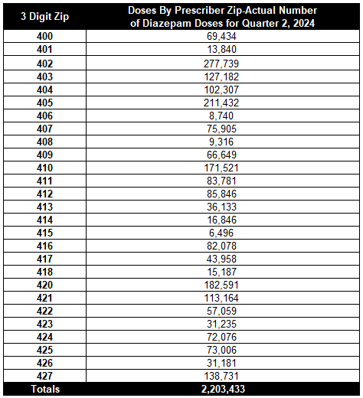
Diazepam Prescribing Q2 2024

Slide 30
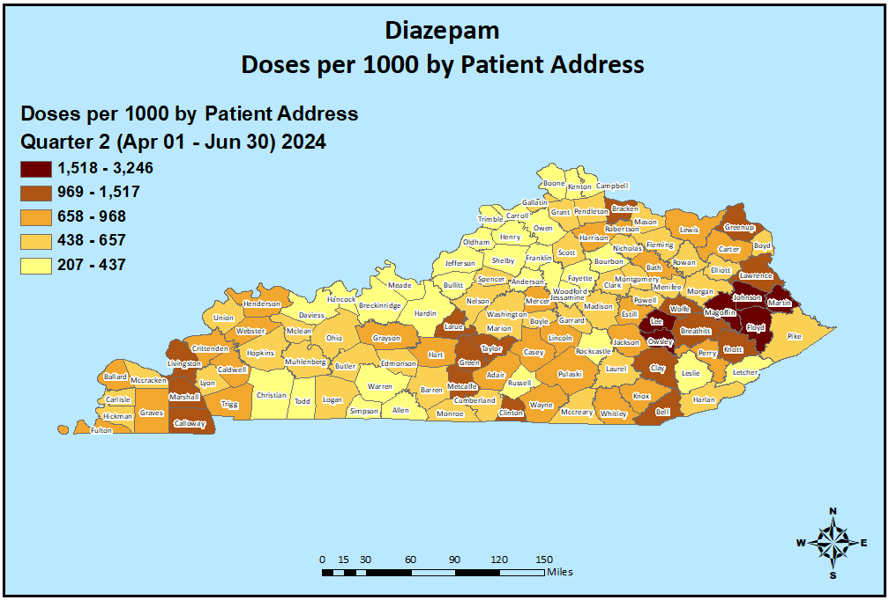
Diazepam Usage Q2 2024

Slide 31
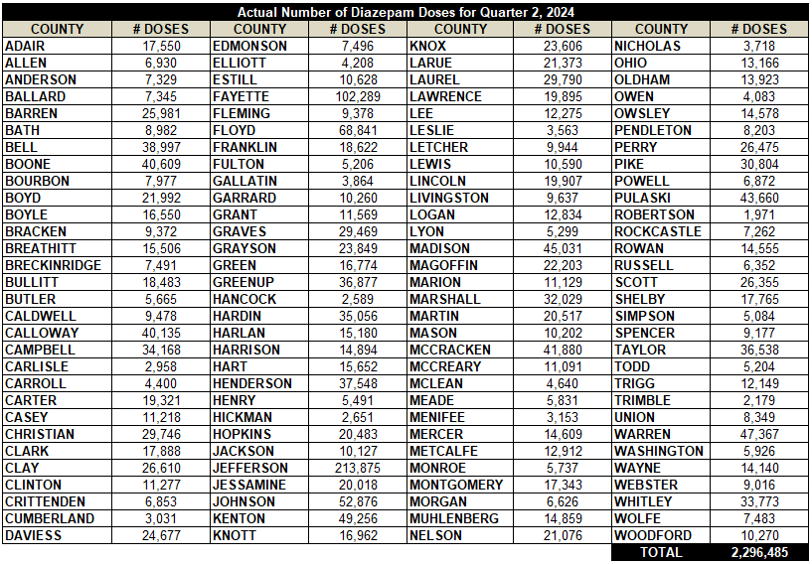
Diazepam Usage Q2 2024

Slide 32
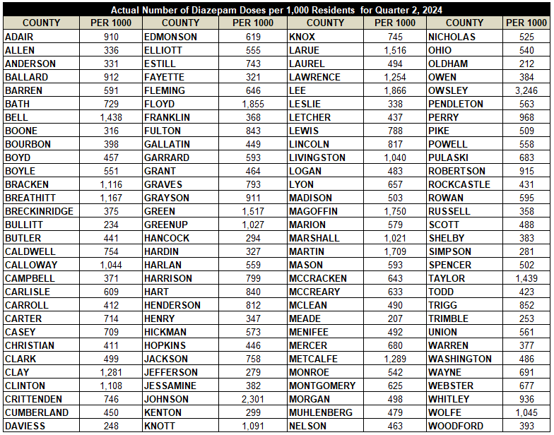
Per 1000 Diazepam Usage Q2 2024

Slide 33
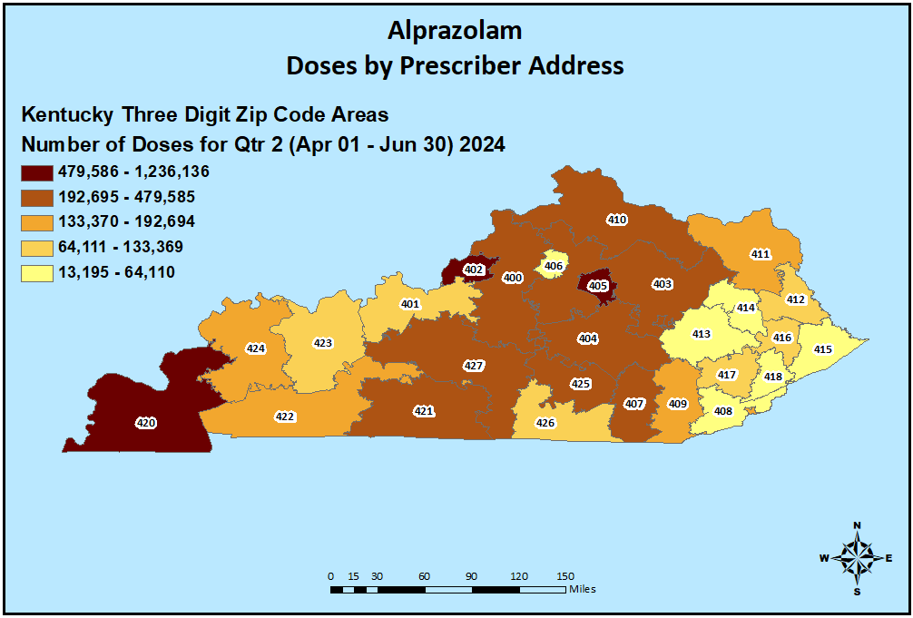
Alprazolam Prescribing Q2 2024

Slide 34
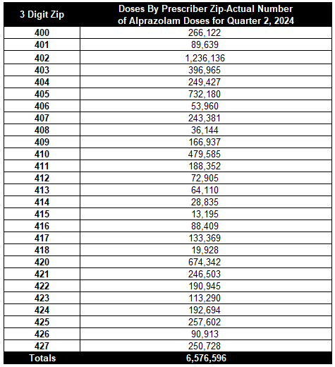
Alprazolam Prescribing Q2 2024

Slide 35
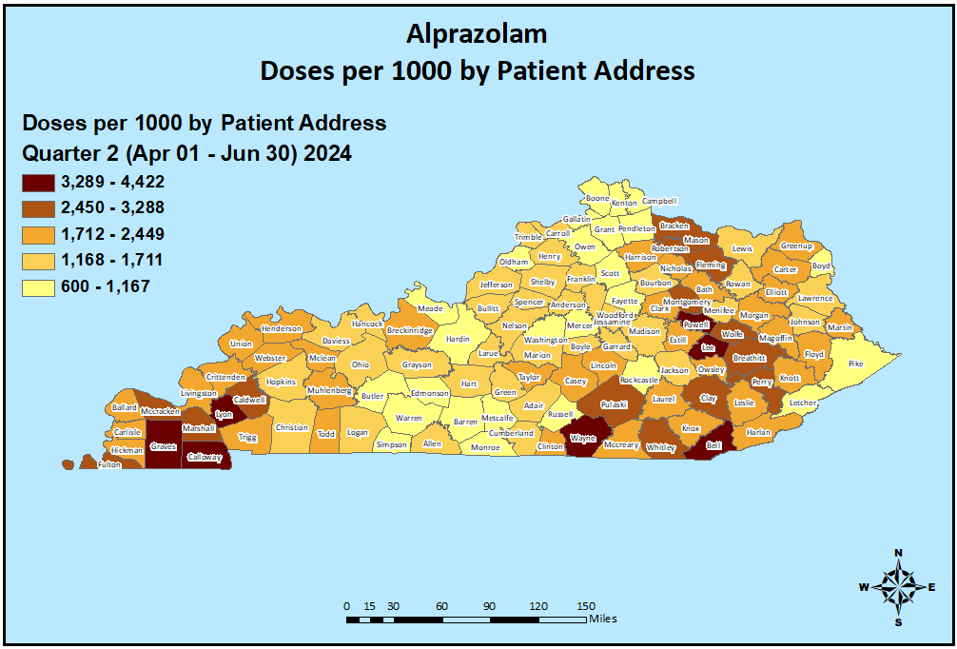
Alprazolam Usage Q2 2024

Slide 36
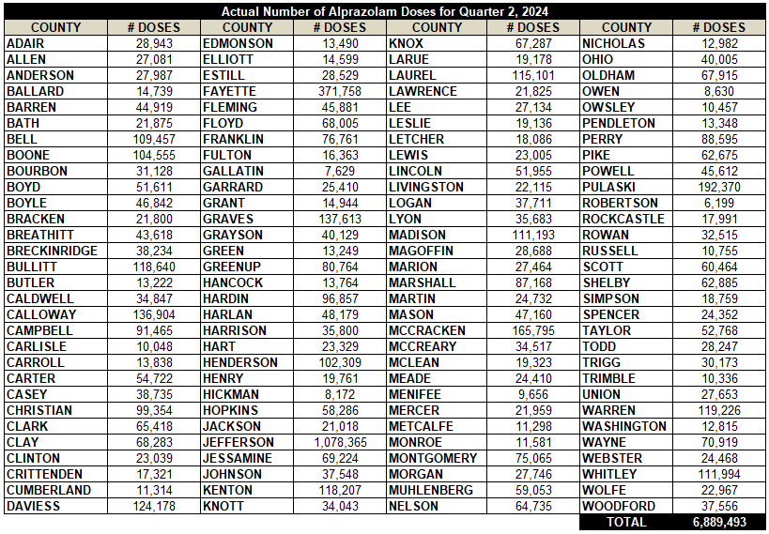
Alprazolam Usage Q2 2024

Slide 37
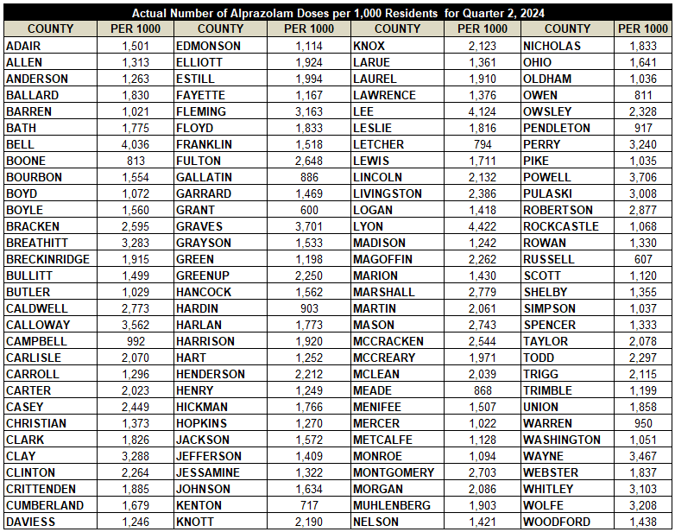
Per 1000 Alprazolam Usage Q2 2024

Slide 38
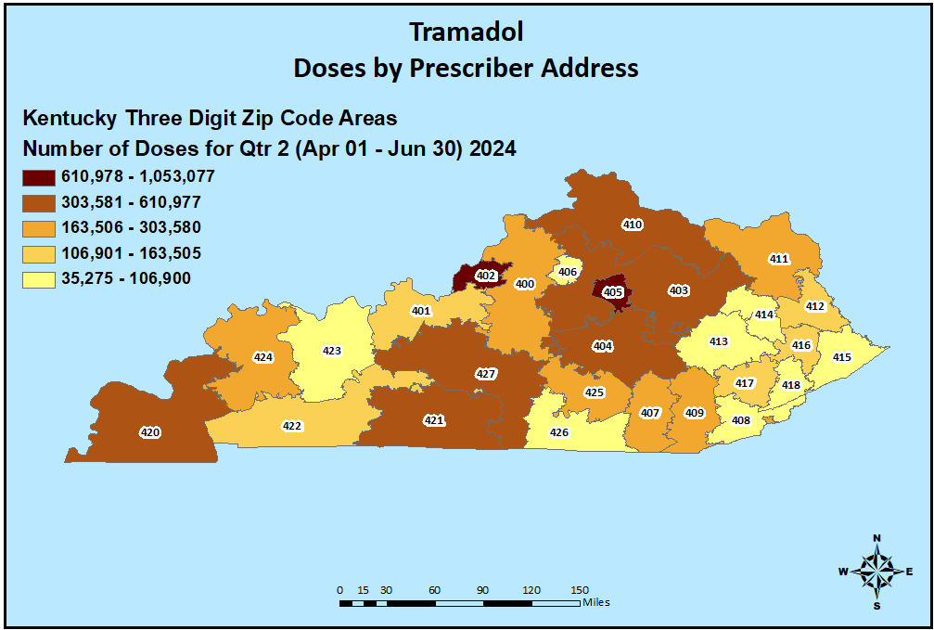
Tramadol Prescribing Q2 2024

Slide 39
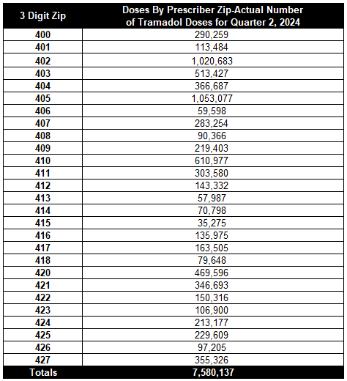
Tramadol Prescribing Q2 2024

Slide 40
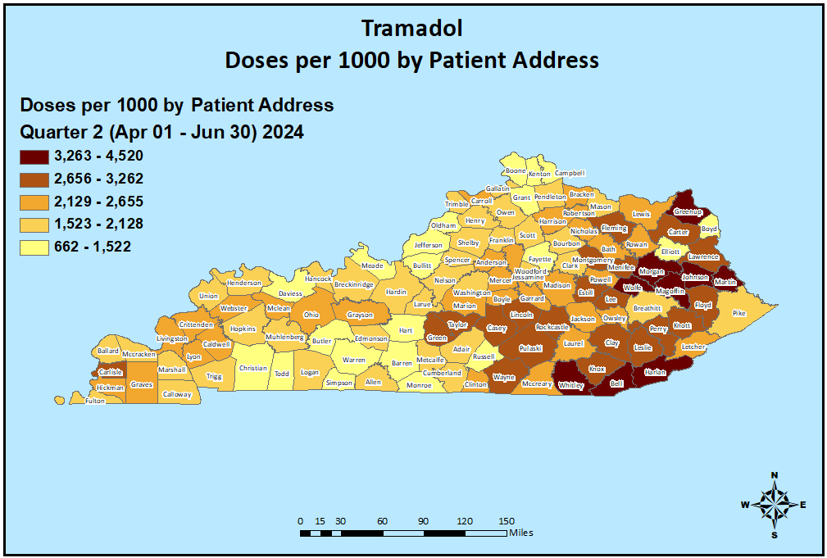
Tramadol Usage Q2 2024

Slide 41
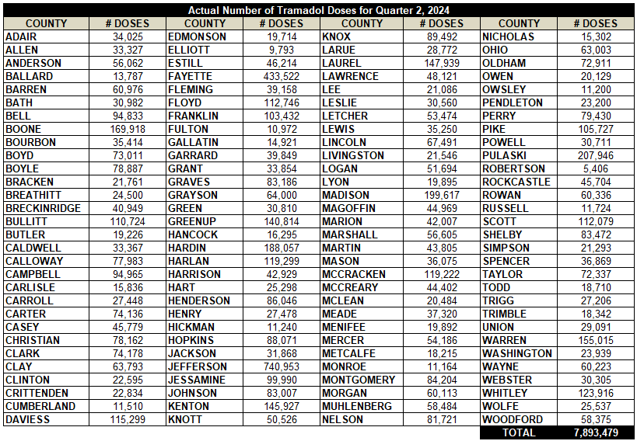
Tramadol Usage Q2 2024

Slide 42
Per 1000 Tramadol Usage Q2 2024

Slide 43
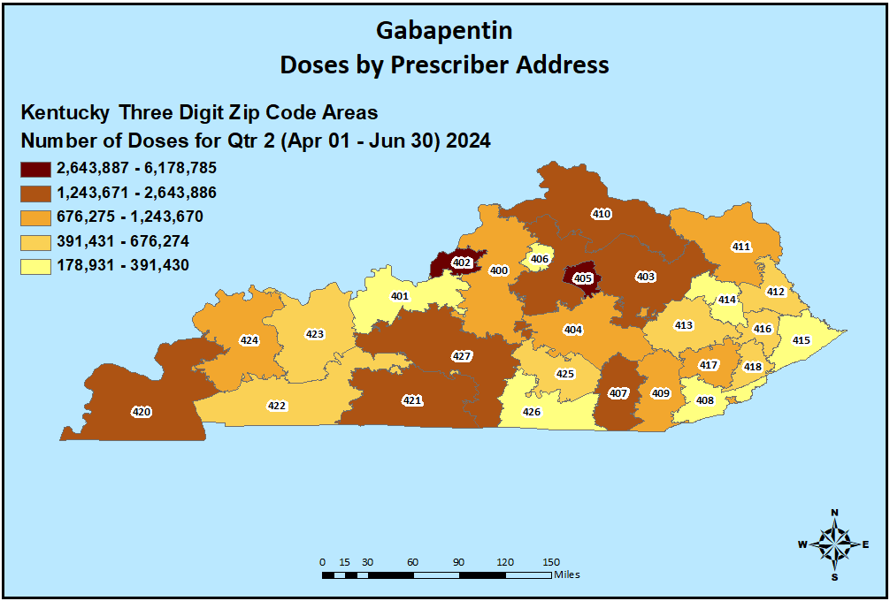
Gabapentin Prescribing Q2 2024

Slide 44
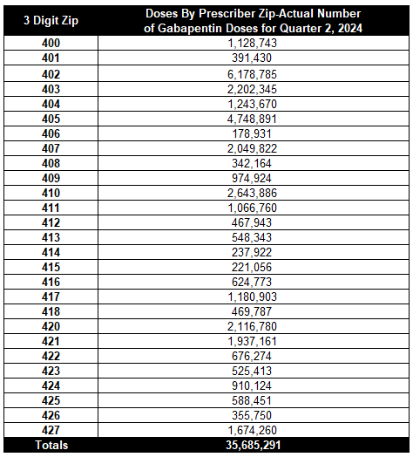
Gabapentin Prescribing Q2 2024

Slide 45
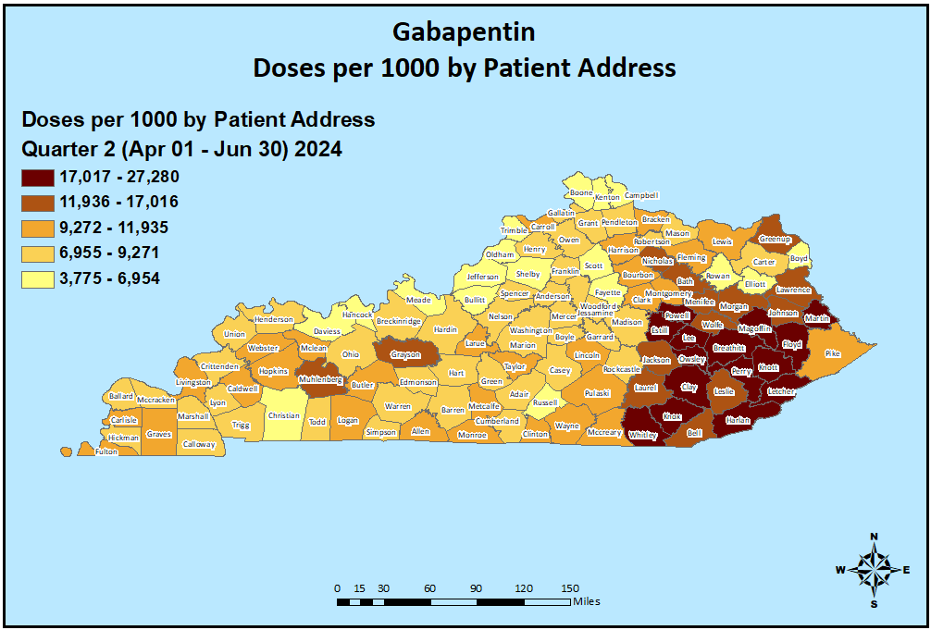
Gabapentin Usage Q2 2024

Slide 46
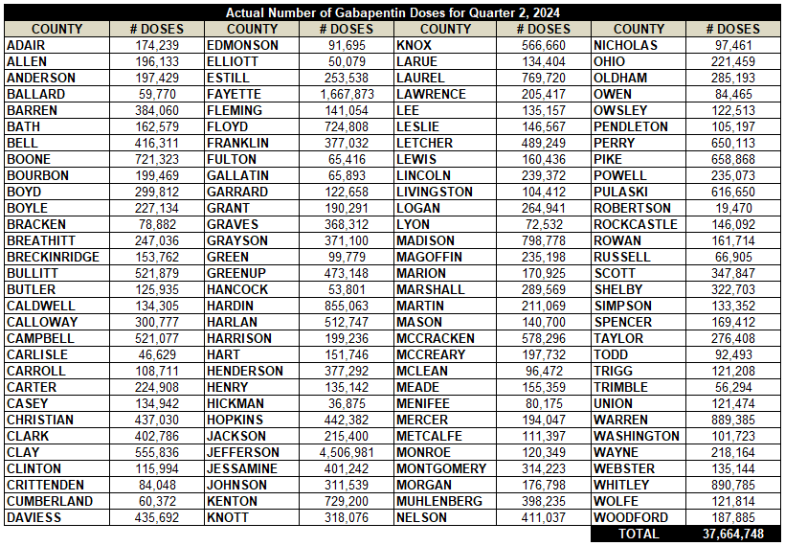
Gabapentin Usage Q2 2024

Slide 47
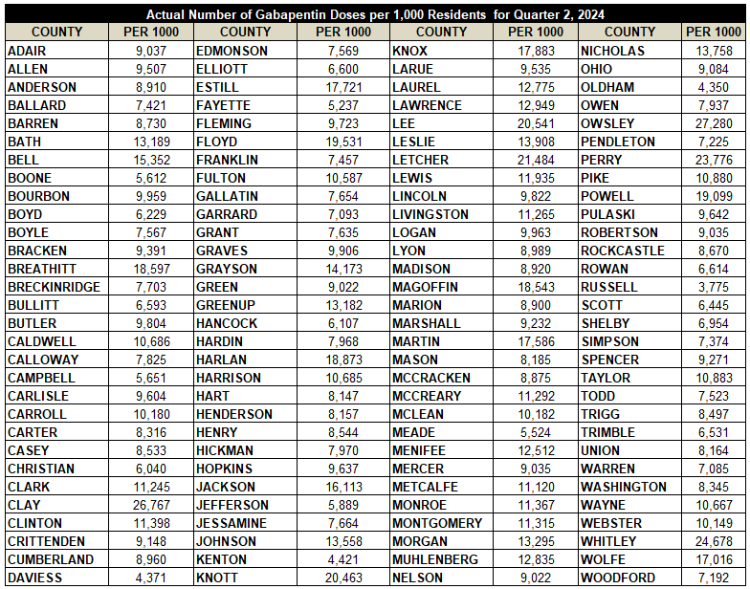
Per 1000 Gabapentin Usage Q2 2024

Slide 48
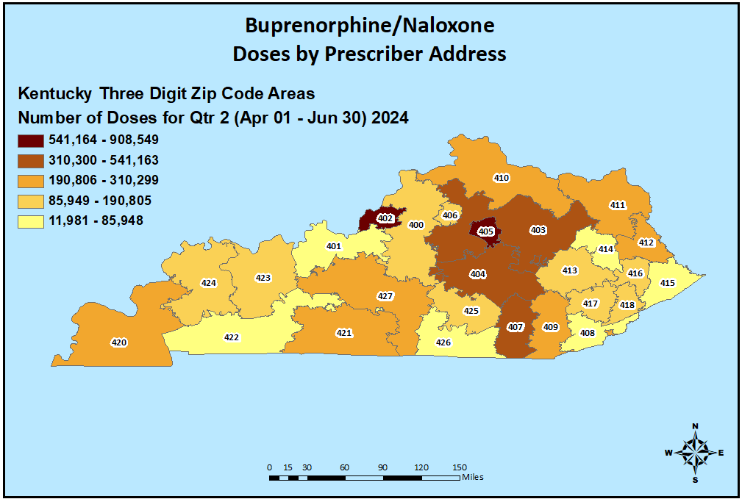
Buprenorphine/Naloxone Prescribing Q2 2024

Slide 49
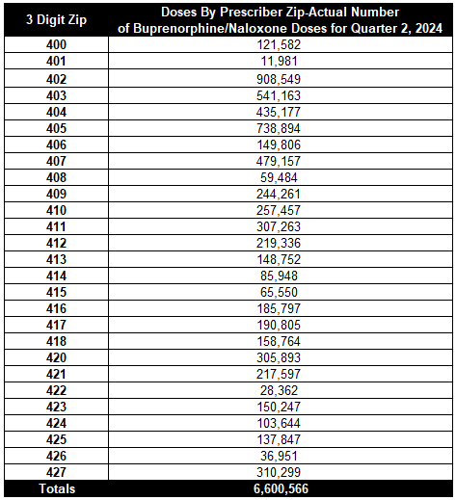
Buprenorphine/Naloxone Prescribing Q2 2024

Slide 50
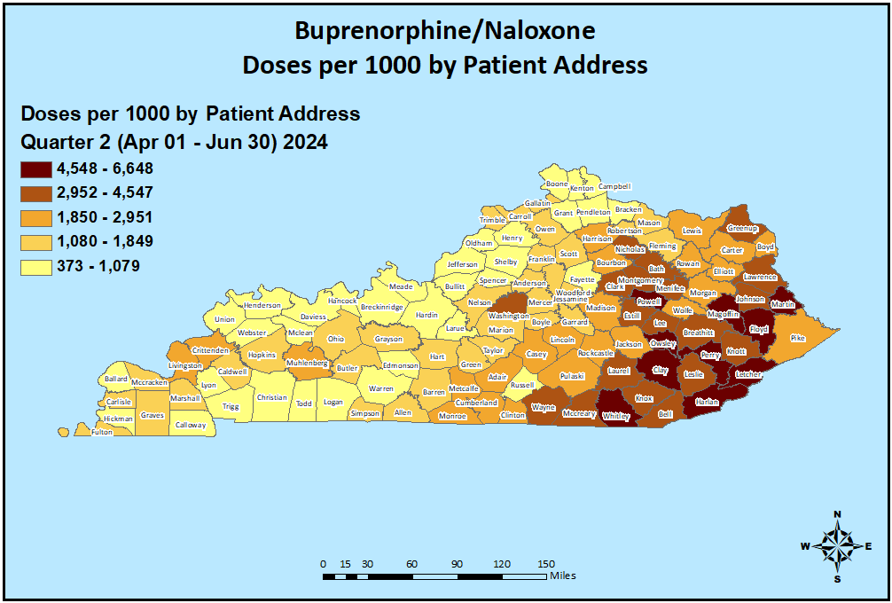
Buprenorphine/Naloxone Usage Q2 2024

Slide 51
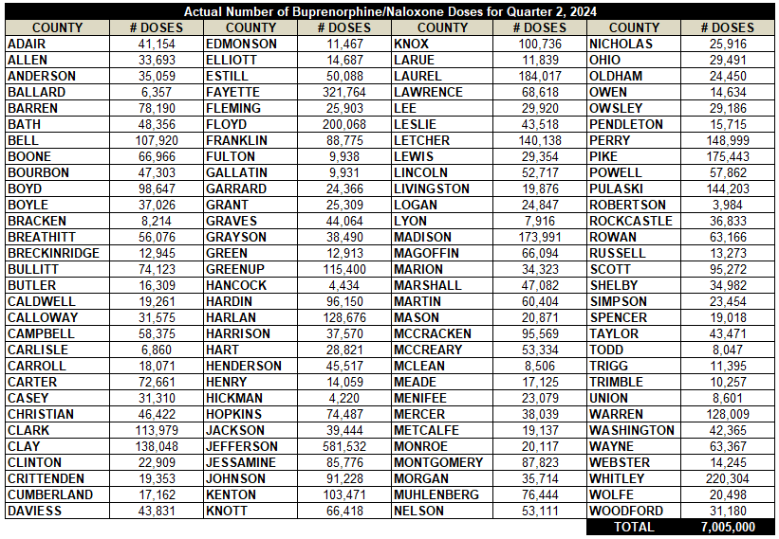
Buprenorphine/Naloxone Usage Q2 2024

Slide 52
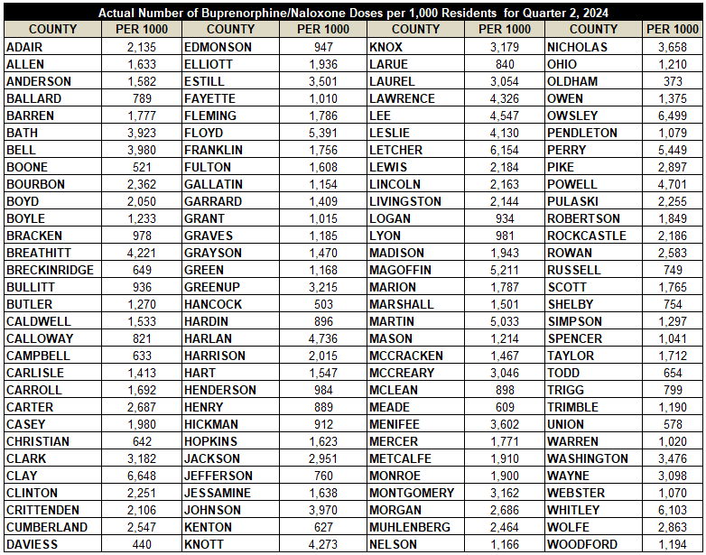
Per 1000 Buprenorphine/Naloxone Usage Q2 2024

Slide 53
Oxymorphone Prescribing Q2 2024

Slide 54
Oxymorphone Prescribing Q2 2024

Slide 55
Oxymorphone Usage Q2 2024

Slide 56
Oxymorphone Usage Q2 2024

Slide 57
Per 1000 Oxymorphone Usage Q2 2024

